Slide 1
Course Introduction and Agile Overview

Slide 2
Agenda
Review course expectations
The Agile mindset
Agile Manifesto and Principles
Agile Processes and Techniques
Kanban
eXtreme Programming
Feature Driven Development
Lean Software Development
Differences between traditional project management and Agile

Slide 3
Course Expectations
Be sure to watch the Introduction to 570 video
You are expected to read all required readings BEFORE class
You are expected to have a working microphone for class as this class will be interactive

Slide 4
Level Set Polls
Agree if you are involved in project management, Disagree if not
Agree if you work on a Scrum or Agile team, Disagree if not
Agree if you work in software development or IT operations, Disagree if not
Agree if your organization uses traditional project management practices (waterfall), Disagree if not
Agree if your organization uses Scrum or Agile, Disagree if not

Slide 5
The Agile Mindset
Agile isn’t just something you do. It’s a way you go about doing what you do and the reason you do what you do.
Agile is not a methodology or framework and it is not a set of processes or practices
Agile is a philosophy which contains values and principles and is really a mindset
What you do needs to build off the mindset

Slide 6
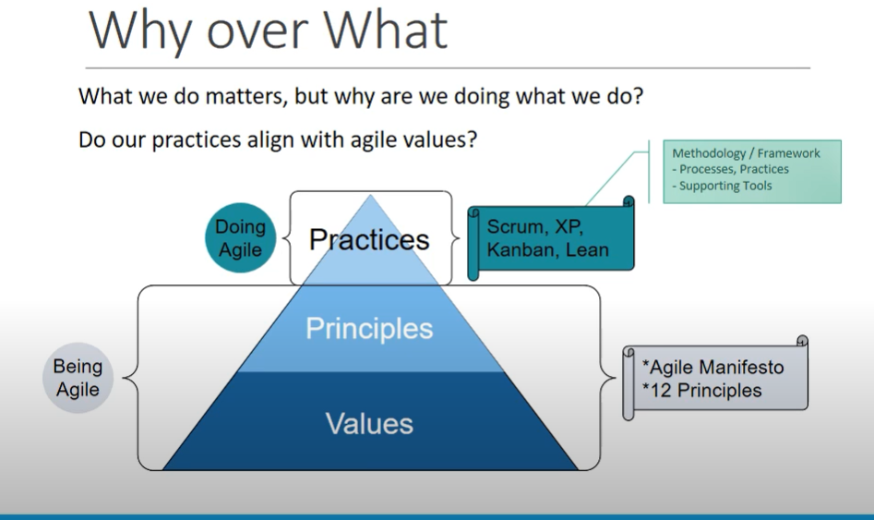
The Agile Mindset
There are Practices and Techniques that help you “Do Agile” but they are based on the agile values and principles
The Agile Values are spelled out in the Agile Manifesto
The Agile Principles are spelled out in the 12 agile principles which was created at the same time as the Agile Manifesto
Some practices and techniques that sit on top of these values and principles are Scrum, eXtreme Programming (XP), Kanban, and Lean.
Reference: https://www.youtube.com/watch?v=ReXisWaK6Lg

Slide 7
Agile Poll
Agree if you have worked with Scrum, XP, Lean, or Kanban, Disagree if not

Slide 8
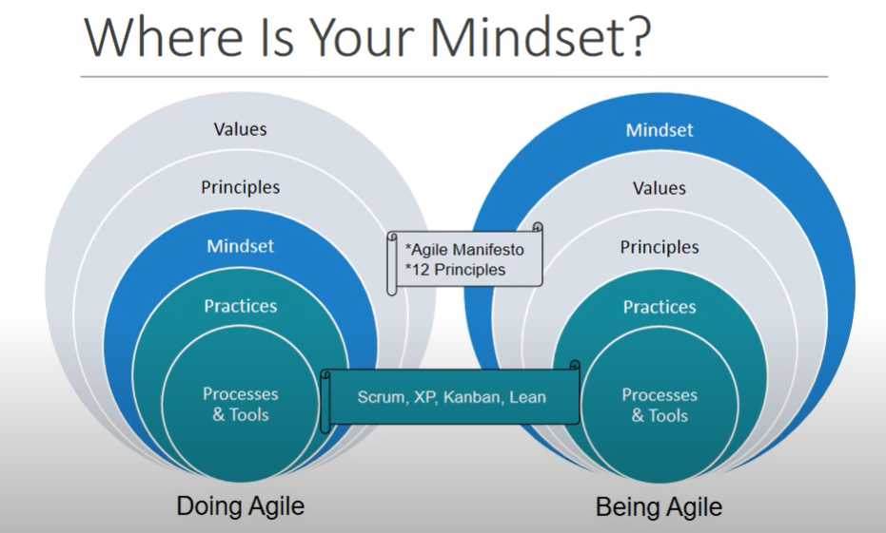
The Agile Mindset
Doing Agile vs. Being Agile
When you are doing Agile you are more focused on the processes, tools, and practices and less focused on the mindset
As you understand Agile and evolve you focus on the Agile Mindset
Reference: https://www.youtube.com/watch?v=ReXisWaK6Lg

Slide 9
The Agile Mindset
What does working agile feel like?
Be ready to provide 1 adjective you heard the most
https://www.youtube.com/watch?v=8eqhuPHS45U
Length 2:30

Slide 10
The Agile Manifesto
Agile Manifesto
www.agilemanifesto.org
We are uncovering better ways of developing software by doing it and helping others do it. Through this work we have come to value:
1
2
3
4
Individuals and interactions
over
Processes and
tools
Functional
software
over
Comprehensive documentation
Customer
collaboration
over
Contract
negotiation
Responding to change
over
Following a plan
That is, while there is value on the items on the right, we value the items on the left more.
Instant Poll: In the chat which do you think might be most important (use numbers of the left), or all the same?

Slide 11
The Agile Manifesto
Individuals and interactions
over
Processes and
tools
We value those items on the left more than we value those on the right but that does not mean we do not have processes and tools in Agile.
Projects are done and products are developed by people and not processes and tools
People are not Resources they are individual people, take a people first approach
Individuals and interactions include collaboration, trust, and team work
Individuals and interactions also includes empowered and self-directed teams that are trusted
We want to eliminate finger pointing and allow teams to experiment
We want to have and use as low of a level of technology as possible. We prefer face to face communication if and when possible.
Jira is not agile just because you use a tool that helps agile teams facilitate their processes and techniques you are not agile
There is often a need for processes and tools but put more value on individuals and interactions
If processes and tools were more important the tools would drive the processes and the processes would dictate what is done. There would be a more “one size fits all” mentality along with much more command and control which are the opposites of Agile

Slide 12
The Agile Manifesto
Functional
software
over
Comprehensive documentation
There is no value until some part of the software is done and delivered, people do not use documents they use software
Does not mean there is no documentation but instead barely sufficient and enough documentation to get the software to done.
Functional software is working software and the true measure of progress, if the software is not working then it’s not done and has no value
This leads us to think about slicing software features and functionality different so a whole slice can be delivered and of value
There is progressive elaboration of the software instead of a full and complete design document then all development being done before there is value
If we want comprehensive documentation we want very detailed specifications and there must be a document before anything is done.
Comprehensive documentation is a very waterfall mindset instead of an agile mindset
Comprehensive documentation may lead to analysis paralysis and no software value is derived

Slide 13
The Agile Manifesto
Customer
collaboration
over
Contract
negotiation
We welcome change which can only take place with customer collaboration
We want frequent communication that is not determined by a communication plan outlined in a contract
We want to do the right work at the right time, doing the next right thing
We want to collaborate and have a value-driven partnership
If we worry more about the contract than collaboration then we become inflexible and increase documentation to make sure the contract is met
There is not much trust built if the contract must spell out everything
Without customer collaboration you end up just checking boxes

Slide 14
The Agile Manifesto
Responding to change
over
Following a plan
We do still have a plan at different times but not a long term, definitive plan
No plan is perfect and we need to account for that
Often a plan is useless shortly after being created
Software development is not predictive
We need to plan to re-plan and leave as many decisions to the last responsible moment
Responding to change instead of following a distinct plan allows us to be adaptive
If we worry more about following a plan then we are more committed to being accurate upfront instead of doing the right thing
If we worry about following a plan we want to know everything up front with detailed schedules and want to stick to a plan instead of having the ability to change
Following a plan works for more predictive projects

Slide 15
The 12 Agile Principles
12 Principles of Agile Manifesto
Be prepared to tell me what you think the most important of the 12 principles is
https://www.youtube.com/watch?time_continue=7&v=jSayJF0epJs&feature=emb_logo
Length 7:00

Slide 16
Kanban
Kanban is a Japanese word for visual signal
Kanban is a work management system to visualize work, limit work in progress, and maximize flow
Work in progress is all work within the system (i.e. project or product release) that is currently being worked on
Flow is the efficiency of work
Kanban helps you to see your work, show it to others, and make sure everyone is on the same page without much explanation (i.e. information radiator)

Slide 17
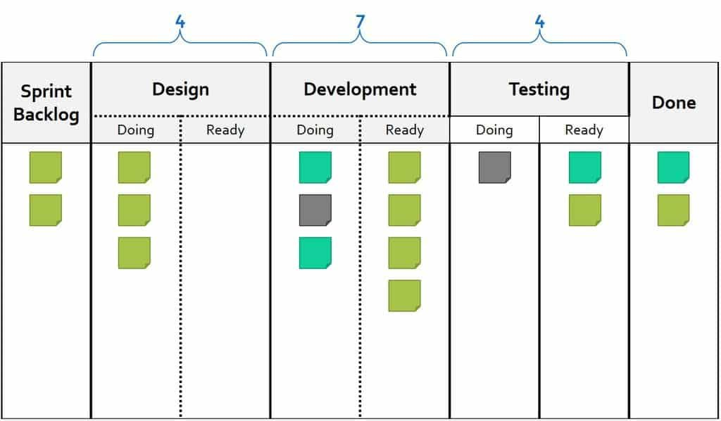
Kanban
Use of Kanban
Includes the use of a Kanban board
Includes the use of Kanban cards
Includes WIP (work in progress) limits
Start with what you do now
Each column would be a step in the process
Each card represents work to be completed
Move a card from one step to the next when that step is completed – a pull system which pulls work from left to right

Slide 18
Kanban
Use of Kanban
WIP limit puts an upper limit on the number of cards in each step
Very useful for identifying bottlenecks and unplanned work
Bottlenecks are processes which stop flow. They prevent cards from moving quickly from left to right. This could be awaiting an approval or could be one step has less people working on it so work piles up.
Unplanned work is something the team did not plan to do but must do. This can be especially important with maintenance type activities such as help desks

Slide 19
Kanban
What is Kanban
https://www.youtube.com/watch?v=iVaFVa7HYj4&feature=emb_logo
Length 5:30

Slide 20
Kanban
Poll: Thumbs up if you have had any experience with Kanban either in manufacturing or otherwise, Thumbs down if no
570 Sample Board on Trello:
https://trello.com/b/l5HInL6x/570-sample

Slide 21
eXtreme Programming (XP)
Created by Kent Beck
Emphasizes technical practices which are often incorporated into Scrum
Based on iterative delivery (get what you want, when you want it not long term)
Customer works directly with the development team to define and prioritize user stories which are small units of functionality.
Team self-organizes around problem and delivers work at the end of an iteration, usually 1-3 weeks

Slide 22
eXtreme Programming (XP)
XP Values
Communication – developers and customer working together constantly
Simplicity – solve today’s problem today, complexity is expensive
Feedback – provide small units of work each iteration to be reviewed and get feedback
Courage – being able to build for today only and refactor later for future needs. Also knowing when to throw away code that is obsolete no matter how much effort was put into creating it
Respect – developers should never commit changes that break the build which is shared and delays the work of others. Team members respect their work by always striving for high quality and seeking for the best design for the solution at hand via refactoring

Slide 23
eXtreme Programming (XP)
12 Practices
Fine scale feedback
Pair programming
Planning game
Test driven development
Whole team
Continuous Process
Continuous Integration
Design Improvement
Small Releases
Shared Understanding
Coding standards
Collective code ownership
Simple design
System metaphor
Programmer welfare
Sustainable pace

Slide 24
eXtreme Programming (XP)
eXtreme Programming (XP) Overview
https://www.youtube.com/watch?v=X6ObCFZlfFk&feature=emb_logo
Length 6:30

Slide 25
eXtreme Programming (XP)
Poll: Thumbs up if you have had any experience with XP or any of the practices of XP, Thumbs down if no

Slide 26
Feature Driven Development
An iterative model for developing software
Focuses on
Developing an overall model
Building a features list
Plan by those features
Design by those features
Build by those features
Core set of software engineering best practices:
Developing by feature
Feature teams
Inspections
Regular builds
Visibility of progress and results
Configuration management
Individual class ownership
Domain object modelling

Slide 27
Feature Driven Development
Feature Driven Development
https://www.youtube.com/watch?v=G-BshQ0OYyo&feature=emb_logo
Length 4:00
Length 4:00

Slide 28
Lean Software Development
Applies the lean principles from manufacturing to software development
Lean development principles
Eliminate waste – eliminate anything from the process that does not add value to the customer
Build quality in – do not expect tests to find quality issues prevent quality issue instead
Create knowledge – provide structure to properly document and retain valuable learning
Defer commitment – demonstrate responsibility by keeping options open and continuously collect information instead of making decisions without necessary data
Deliver fast – build a simple solution, put in front of the customer, enhance incrementally based on feedback
Respect for people – communicating proactively, encouraging healthy conflict, and surface work-related issues as a team
Optimize the whole – eliminate long cycle times by operating with a better understanding of capacity and downstream impact of work

Slide 29
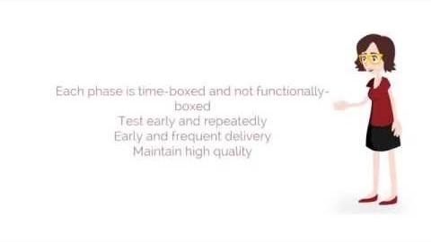
Lean Software Development
Length 6:00

Slide 30
Traditional Software Development
Traditional software development also known as waterfall or PMBOK is the type of project management that you learned in 510
Traditional software development methods include the work divided into phases and one can not start until the previous one ends which is where the term waterfall comes from
Typical phases
Requirements
Design
Development
Test
Go Live

Slide 31
Traditional Software Development
Traditional software development usually wants all requirements to be defined during the requirements phase and not change afterward, or a change control process must be used to make any changes]
The design phase takes the input of the requirements document and attempts to design all elements of the system and document them
The development phase takes the design documents and creates software from the design
The testing phase tests the completed work from the development phase against the requirements that were created in the requirements phase. Also includes user acceptance testing where users are able to test the full system

Slide 32
Traditional Software Development
Common Traditional Software Development Phrases:
We need a common set of processes, tools, and templates
We need a detailed project plan, schedule, and budget
What percent complete is that task?
We need more resources
That is part of the change control process
Scope creep
Do we need to document?
How many hours will this take?
On time and on budget
I can’t estimate without details
We need you to sign off on the detailed requirements document

Slide 33
Agile Project Management vs. Traditional Project Management
Agile Project Management vs. Traditional Project Management
https://www.youtube.com/watch?v=tZb5G4GXNLI&feature=emb_logo
Length 2:30

Slide 34
Traditional Software Development
If you have used traditional project management techniques and also any of the Agile techniques mentioned how was your experience different?

Slide 35
Additional Activities (Supplemental)
Read The New New Product Development Game
Watch The Agile Mindset YouTube video
Watch Why “Doing” Agile is the wrong approach YouTube video
Watch Introduction to Kanban by Kanban Dan

